Slide 1
Cardio Good Fitness Case Study

Slide 2
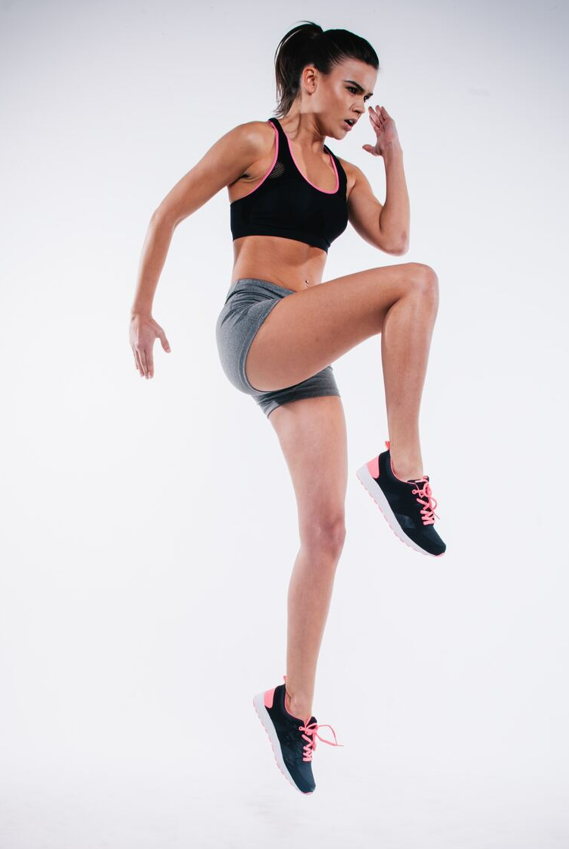
Background
The market research team at AdRight is assigned the task to identify the profile of the typical customer for each treadmill product offered by CardioGood Fitness.
The team identifies the following customer variables to study: product purchased, TM195, TM498, or TM798; gender; age, in years; education, in years; relationship status, single or partnered; annual household income ; average number of times the customer plans to use the treadmill each week; average number of miles the customer expects to walk/run each week; and self-rated fitness on an 1-to-5 scale, where 1 is poor shape and 5 is excellent shape.
The market research team decides to investigate whether there are differences across the product lines with respect to customer characteristics.
The team decides to collect data on individuals who purchased a treadmill at a CardioGoodFitness retail store during the prior three months.

Slide 3
Objective
To do Preliminary Data Analysis. Explore the dataset and practice extracting basic observations about the data.
We will be focusing on the following:
Come up with a customer profile (characteristics of a customer) of the different products
Perform uni-variate and multi-variate analyses
Generate a set of insights and recommendations that will help the company in targeting new customers

Slide 4
Data Information
Variable | Description
Product | The model no. of the treadmill
Age | Age in no. of years of the customer
Gender | Gender of the customer
Education | Education in no. of years of the customer
Marital Status | Marital Status of the customer
Usage | Avg. no. of times the customer wants to use the treadmill every week
Fitness | Self rated fitness score of the customer (5 - very fit, 1 - very unfit)
Income | Income of the customer
Miles | Miles expected to run
Observations | Variables | Duration
180 | 9 | 3 months

Slide 5
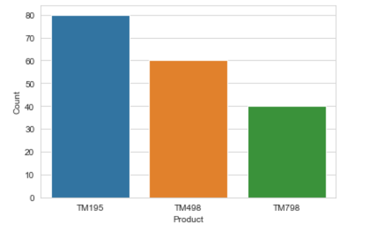
Exploratory Data Analysis – Product
Insights:
TM195 is the most popular product at 80 owners
TM498 is 2nd with 60 owners
TM798 is 3rd with 40 owners

Slide 6
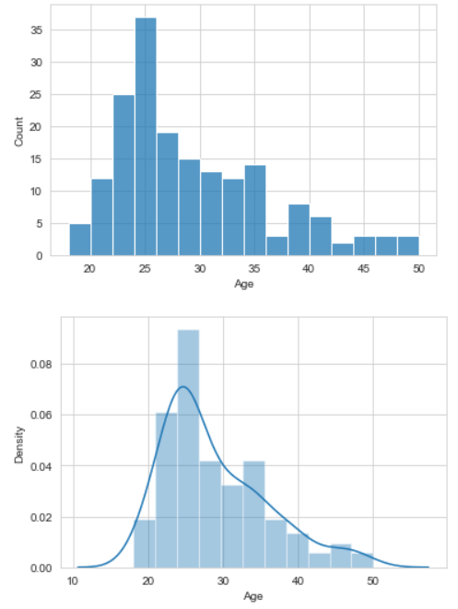
Exploratory Data Analysis – Age
Insights:
Most of Cardio Good Fitness customers are between ages 20 to 36

Slide 7
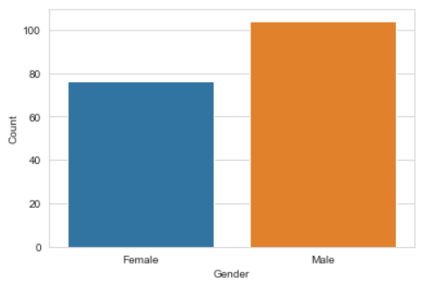
Exploratory Data Analysis – Gender
Insights:
More of Cardio Good Fitness customers are male than female at 104 versus 76

Slide 8
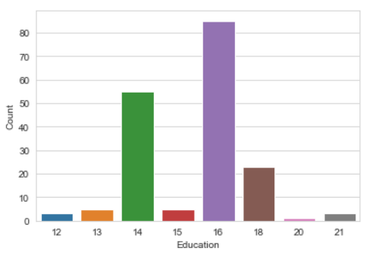
Exploratory Data Analysis – Education
Insights:
A vast majority of customers have 14, 16 and 18 years of education meaning they have completed tertiary education

Slide 9
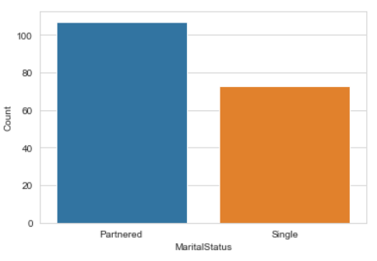
Exploratory Data Analysis – Marital Status
Insights:
More Partnered than Single people are Cardio Good Fitness customers

Slide 10
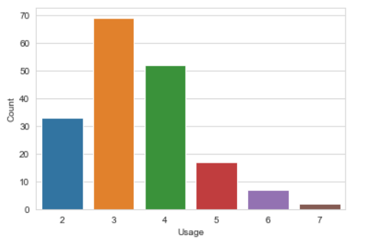
Exploratory Data Analysis – Treadmill Usage
Insights:
Most customers want to use the treadmill between 2-4 times a week with the most being 3 times a week

Slide 11
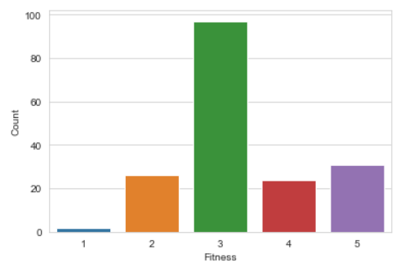
Exploratory Data Analysis – Fitness Ratings
Insights:
Most customers rate themselves as 3 (average) on the fitness scale of 1-5

Slide 12
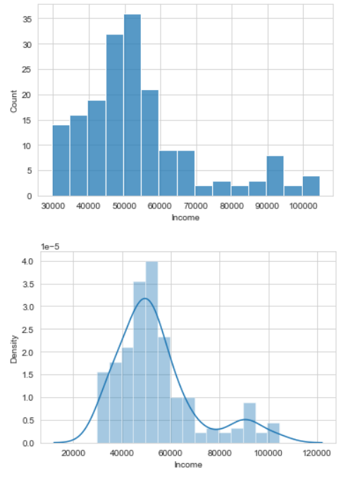
Exploratory Data Analysis – Income
Insights:
Most customers' income range from 30K to 60K

Slide 13
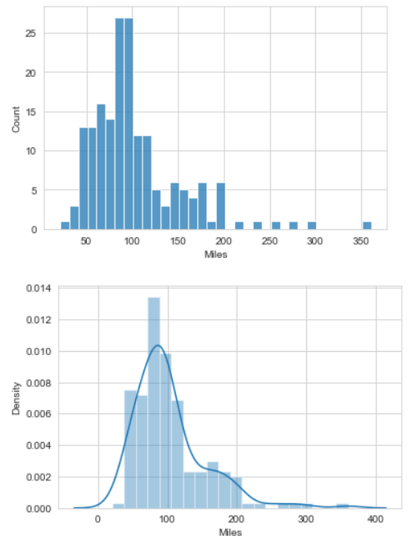
Exploratory Data Analysis – Mileage (Miles Expected to Run)
Insights:
Most customers are expected to run between 50 to 120 miles

Slide 14
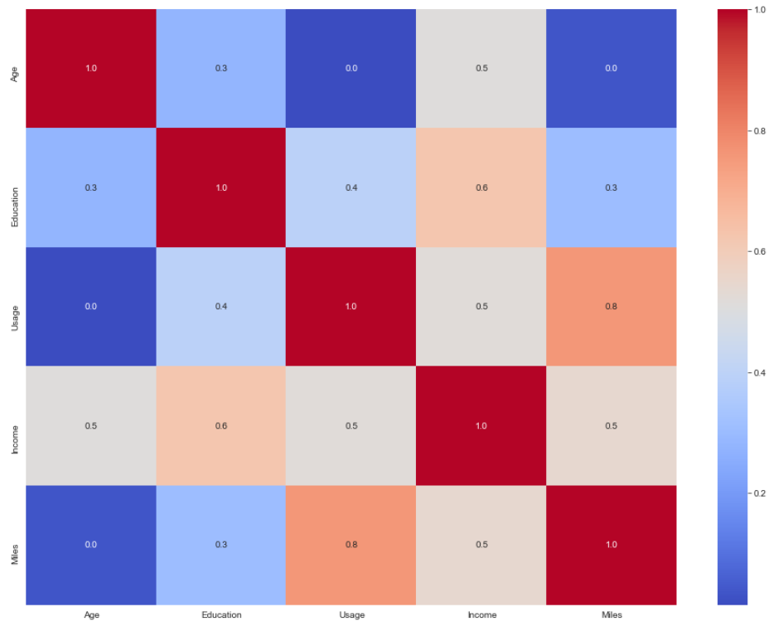
Exploratory Data Analysis – Correlation Matrix
Insights:
There is a high correlation between customer usage of the treadmill with the miles they are expected to run
Usage of the treadmill can be a proxy for miles expected to run

Slide 15
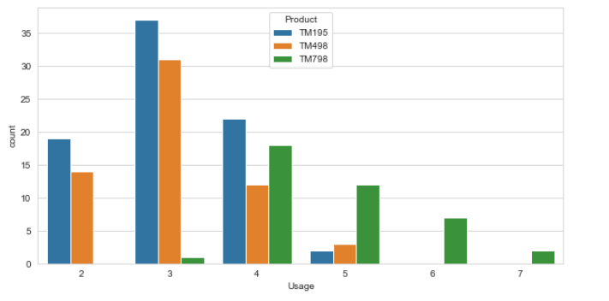
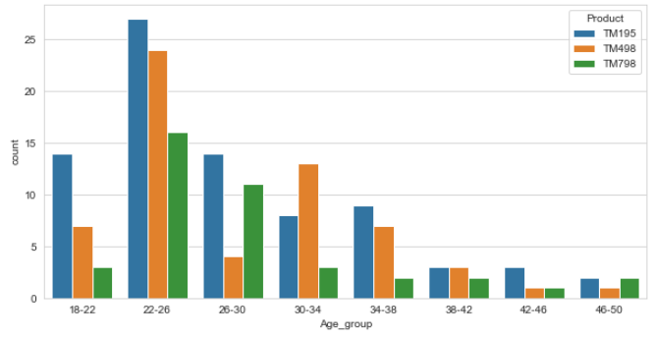
Exploratory Data Analysis – Product , Usage and Age
Insights:
Product models TM195 and TM498 are most popular for customers who want to use treadmills 2 to 4 times a week with most of them at 3 times a week
Insights:
Aged 26-30 years old customers tend to not purchase TM498 over other models
Potential market TM498 to customers age 26 - 30 years old

Slide 16
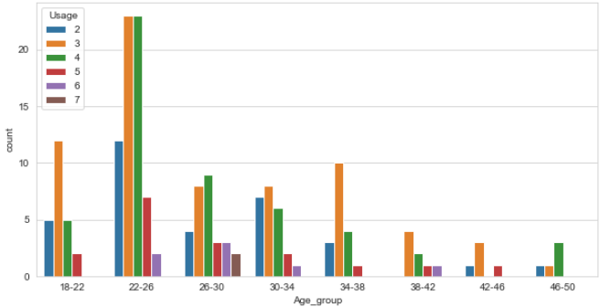
Exploratory Data Analysis – Usage and Age
Insights:
Most 26 - 30 years old customers want to use treadmills 3 to 4 times a week

Slide 17
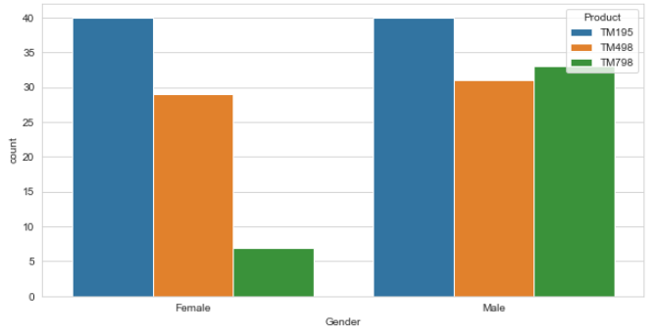
Exploratory Data Analysis – Product , Usage and Gender
Insights:
Product model TM798 is largely unpopular with customers who use treadmills 3 times a week and now only caters to customers with higher usage
Potential to market TM798 to customers who use treadmills 3 times a week
Insights:
TM195 and 498 are comparatively popular with customers of both genders but TM798 is much less popular with the female gender
Potential to market TM798 to female gender

Slide 18
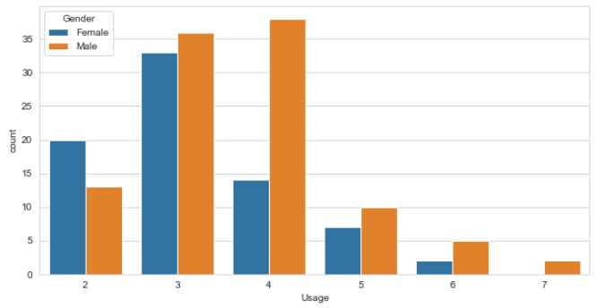
Exploratory Data Analysis – Gender and Usage
Insights:
Female gender usage peaks at using treadmill 3 times a week and less females use treadmill beyond 3 times a week
There is potential market TM798 to female gender who use treadmill 3 times a week

Slide 19
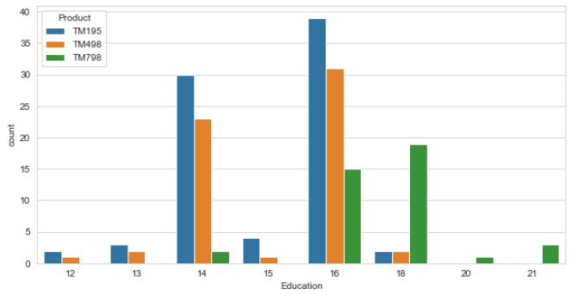
Exploratory Data Analysis – Product Use across Education
Insights:
TM195 and 498 are comparatively popular with customers with both 14 and 16 years education
TM798 product model is much less popular with customers 14 years of education compared to other educational levels

Slide 20
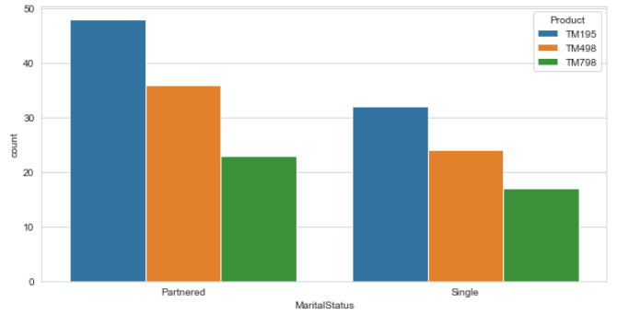
Exploratory Data Analysis – Product Use across Marital Status
Insights:
Product models popularity across marital status is comparable

Slide 21
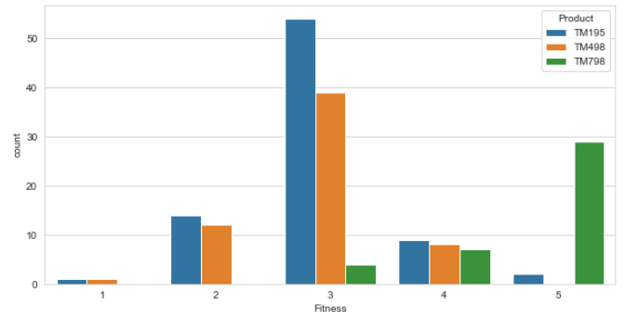
Exploratory Data Analysis – Product Use across Fitness Ratings
Insights:
Most TM195 and TM498 customers rated themselves average in fitness

Slide 22
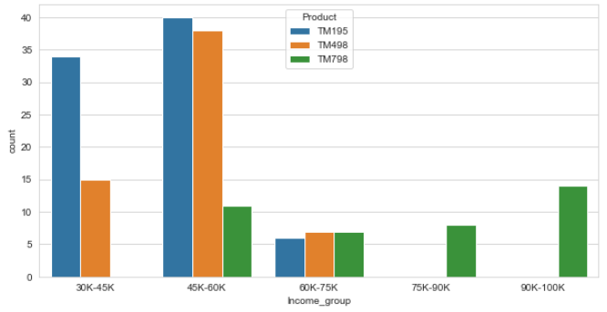
Exploratory Data Analysis – Product Use across Income
Insights:
TM195 and TM498 tended to be purchased by lower income bracket customers while TM798 tended towards higher income bracket customers

Slide 23
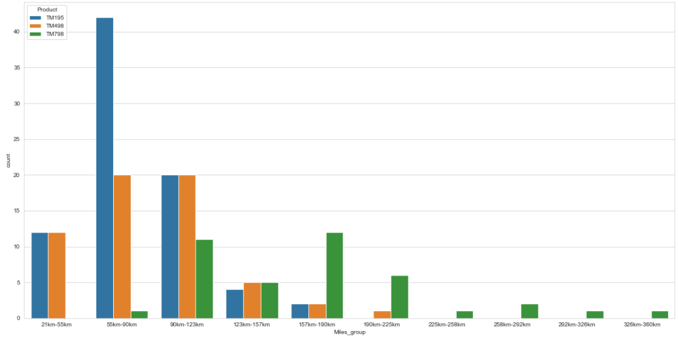
Exploratory Data Analysis – Product Use across Miles
Insights:
TM195 and TM498 tended to be purchased by lower mileage customers while TM798 tended towards higher mileage customers

Slide 24
Conclusion
After all the analysis, we have been able to conclude that
Most 26 - 30 years old customers want to use treadmills 3 to 4 times a week but are not buying the TM498 unlike age groups adjacent to them with similar treadmill usage profiles
There is a disproportionate lack of female customers for the TM798 who mostly want to use the treadmill 3 times a week
TM195 and TM498 appeals to customers who run less a week while TM798 appeals to customers who run more a week

Slide 25
Recommendations
Based on the analysis, the following recommendations can improve the sales
Marketing TM498 to customers of age profile 26 - 30 is recommended
Marketing TM798 to female customers who want to use treadmills 3 times a week is recommended

